Slide 1
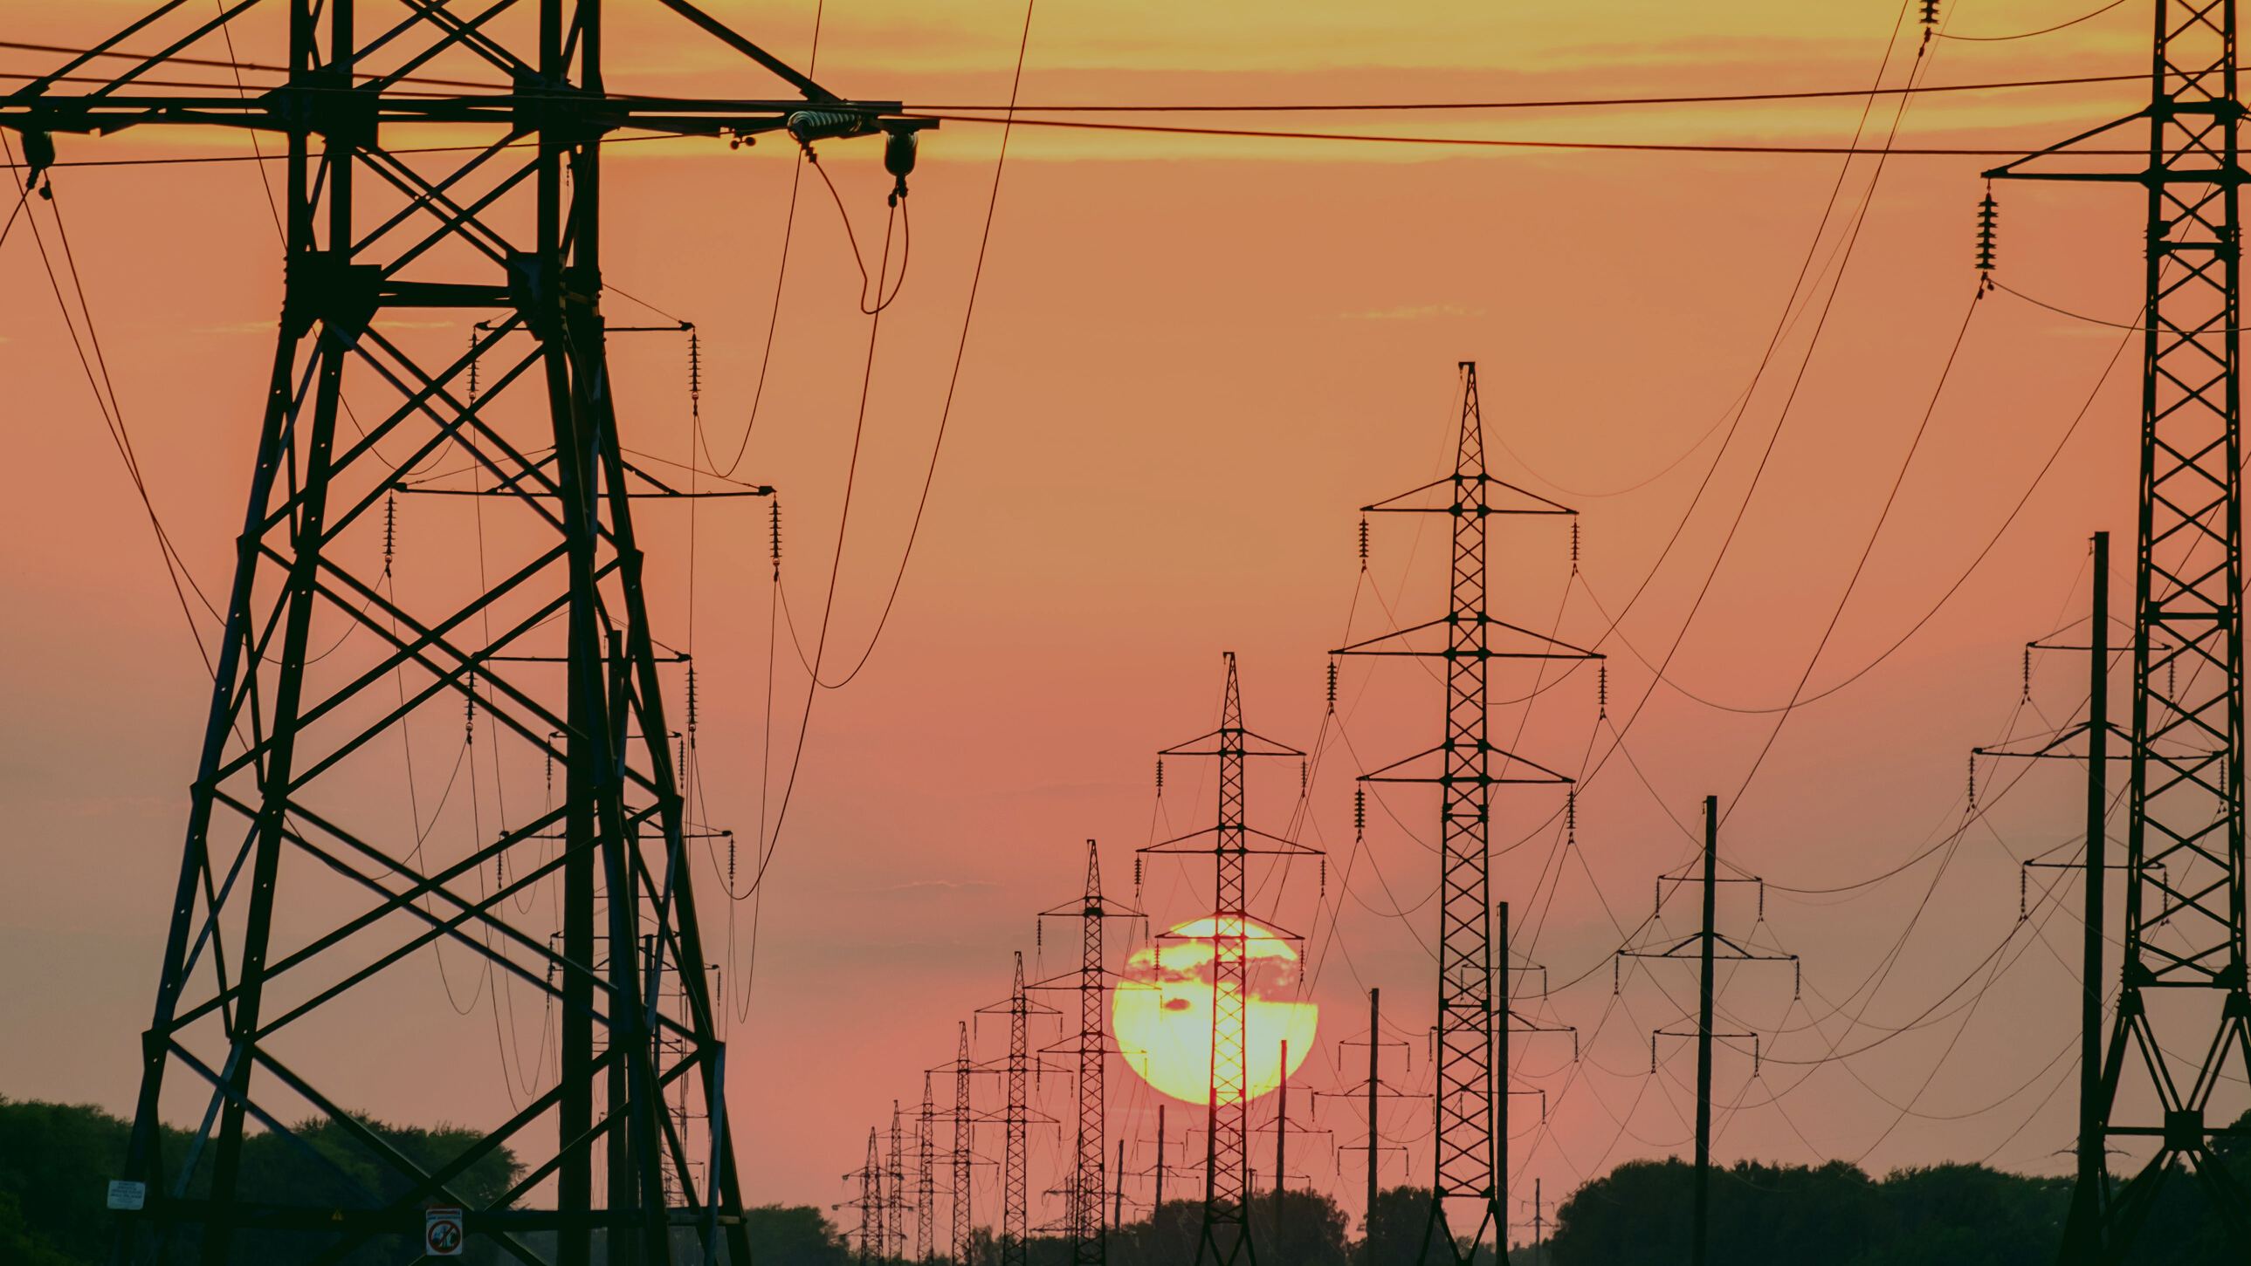
VIEWS/COMMENTS OF GRIDCO ON DRAFT CERC (CONNECTIVITY & GNA TO THE ISTS) REGULATIONS, 2021

Slide 2
Mandatory Compliance to EA-2003, NEP & NTP
  Section 38(2)(c) of Act- CTU should ensure efficient, co-ordinated & economical system.
  Section 61(c) of Act- Competition, efficiency, economical use of resources, good performance & optimum investments.
  Section 61(d) of Act- Consumers’ interest & reasonable cost of electricity.
  Clause 7.3(2) of NTP- Information on available Transmission capacity.
Suggestion
GNA Regulation should bring out the estimated improvement on:
  Total Transmission Capacity (TTC)
  Available Transfer Capability (ATC)
  Margin in ISTS
  Inter-regional Transfer Capability
  Stranded Capacity/assets in ISTS

Slide 3
Generating Companies liable for Sharing of ISTS Charges
  Section 38(2)(d)(i) of Act- ISTS to be used by any licensee or generating company on payment of trans. Charges.
  Cl.5.3.4 of NEP- Competing generators supplying power to licensees upon payment of trans. Charges.
  As per draft Regulations- one time trans. Charge by Generators.
Suggestion
Generators also to share the trans. charges for compliance to Act & Policy.

Slide 4
Validity of Annexure-1 in terms of deemed GNA to the states
Deemed GNA shall be average of “A” for FY 2018-19, 19-20 & 20-21
where,
A= {0.5 x maximum ISTS drawl in a time block during the year} + {0.5 x [av. of (max. ISTS drawl in a time block in a day) during the year]}
Formula not valid as it includes STOA (Temporary GNA)
Reasons:
  T-GNA to be availed over & above GNA.
  Separate products.
  T-GNA granted over available surplus capacity after allocating GNA.
  T-GNA granted subject to availability of surplus capacity after use by LTA & MTOA customers.
  T-GNA granted even for a single time block.
  Temp. drawl of power for a single time block would enhance the GNA.
  Would facilitate capacity addition in ISTS burdening consumers.

Slide 5
Impact on Sharing of Trans. Charges
  Reg.40.1- Sharing of Trans. charges & losses to be shared by buying entities in accordance with the sharing Regulations.
  Cl.6.3 of Explanatory Memorandum- to be shared by buying entities in proportion to their GNA in terms of sharing Regulations.
-In accordance with the above, the States like Odisha would go on sharing of higher Trans. Charges due to higher deemed GNA that includes STOA quantum.
Suggestion
  Deemed GNA of the State be fixed as per given formula basing on the drawl of the state corresponding to LTA & MTOA but excluding STOA.
  Sharing Regulations be amended simultaneously.

Slide 6
Other Intra-State Utilities to qualify for grant of T-GNA
"Reg.26- Eligibility for Temporary GNA
26.1 (a) Eligible buying entities
(i) Dist. Licensee directly connected to ISTS (b) Trading licensee
(ii) Bulk consumers directly connected to ISTS for buying entities under (a)
(iii) Buying entity connected to intra-state trans. System (c) Power exchanges for
(iv) Generating station to meet aux. cons. or start-up power collective transaction or bi-
(v) Captive generating plant lateral transactions for
(vi) Standalone ESS buyers under (a)
Reg.17- Eligibility for GNA
17.1 State Trans.utility on behalf of Dist. Licensees connected to intra-state trans. system and other intra-state entities."
Suggestion
Reg.26.1 should also include other intra-state entities like GRIDCO to avail T-GNA

Slide 7
Un-realistic Relinquishment Charges for Drawing Entity
  Reg.25.1- Relinquishment charges equal to 60 times the trans. charges paid by such intra-state entity for last billing month.
Exa: GRIDCO
  Relinquishment of 200MW GNA out of sanctioned GNA of 2000MW (say).
  Basing on Trans. charges paid for last month say 60 Crores, relinquishment charges is Rs. 360 Crores for relinquishment of only 10% of its sanctioned GNA.
  In case of Generator :
- Conn- BG-1 for Rs. 50 lakhs.
- Conn- BG-2 for terminal bay- Rs. 2 Cr. to 12 Cr.
- Conn- BG-3 of amount at Rs. 2 Lakh/MW.
  Relinquished GNA can be availed by T-GNA grantees.
  No provision in Draft Regulations under following Special Conditions:
- Surrender of PPA with ISGS/ Inter-state Gen. Station (RE target of 500GW till 2030)
. - PPA with ISGS/ Inter-state Gen. Station expires.
Suggestion
  Upto 10% of Sanctioned GNA be exempted.
  Beyond 10%- maximum 5 times.
  Exemption under the above special conditions.

Slide 8
Contradiction in Reg.17 of Draft Reg.
  Reg.17.1 The following entities shall be eligible as Applicants to apply for grant of GNA or for enhancement of quantum of GNA
(i) State Trans. Utility on behalf of dist. Licensees connected to intra-state trans. system and other intra-state entities.
(ii) Buying entity connected to intra-state trans. system.
Clarification required
  Why STU cannot apply for such buying entity connected to intra-state trans. system.
  Whether a Dist. licensee or a Bulk consumer seeking to connect to ISTS directly with a load of 50MW & above would be considered as a state drawing entity by SLDC or to be under jurisdiction of concerned RLDC.

Slide 9
Standing Clearance for Grant of T-GNA
In terms of draft Reg.31.4, where Standing Clearance is issued:
  Concerned T-GNA Grantee to bid in power exchange ensuring that aggregate quantum in each time block for all the bid(s) under bilateral transactions and collective transactions shall not exceed the quantum of Standing Clearance.
  In case of exceeding the quantum in anytime block against the Standing Clearance quantum, NLDC to debar such T-GNA grantee for participation in the said transactions for 7 days.
  List of debarred entities to be displayed on NOAR.
Consequence
Instead of promoting the Power Market (including trading) as per section 66 of EA-2003, such harsh measures would discourage Power Market participants.
Suggestion
The bids of such type of T-GNA Grantee may be curtailed.
Warning messages may be provided by the Power Exchanges.

Slide 10
Other Suggested Modifications/ Incorporations
  In terms of Draft Reg.17.1(ii) & 40.1, Buying entities to be defined.
  Grant of connectivity quantum to be Installed Capacity less Aux. Consumption (Ref: Reg.5.1).
  Payment liability to lie with the GNA Grantee using GNA of other Grantee (Reference- Reg.23.1 of Draft GNA Reg.)
  Stipulation of Clause 2(c) of Expl. Memo for imposition of addl. charges on drawing entities for drawl beyond Sanctioned GNA; but no such provision for Generators for over-injection beyond Sanctioned GNA.
  Liabilities for transmission charges not to be passed to beneficiaries in case of delay/failure in COD of Gen. Stations irrespective of any reason whatsoever.
  Clarification required whether Trans. charges Bills to be served on STU or State Entities individually.

Slide 11
Thanks

